Slide 1


FYP Adjudication Board Spring 2025
Development of an autonomous offroad navigation vehicle

Slide 2

Project Supervisor
Supervisor: Dr. BILAL MUHAMMAD KHAN
2

Slide 3



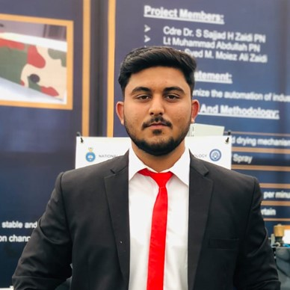

OUR TEAM
SHEHARYAR FAISAL
M.ABDULLAH
M.TAYYAB
M.MUBASHIR
KHANZADA
3

Slide 4

Problem Statement
Woot Tech, a leader in UAV systems for military and defense, aims to add unmanned ground, and surface vehicles (UGVs/USVs) as part of their fleet. The goal is to create a unified, human-in-the-loop mission system that is capable of interfacing with other autonomous vehicles.
4

Slide 5
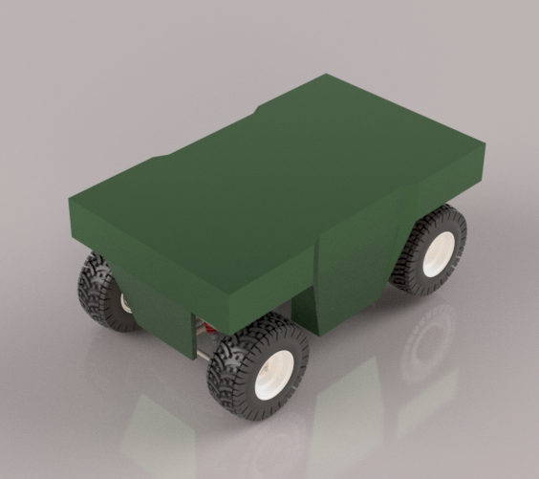
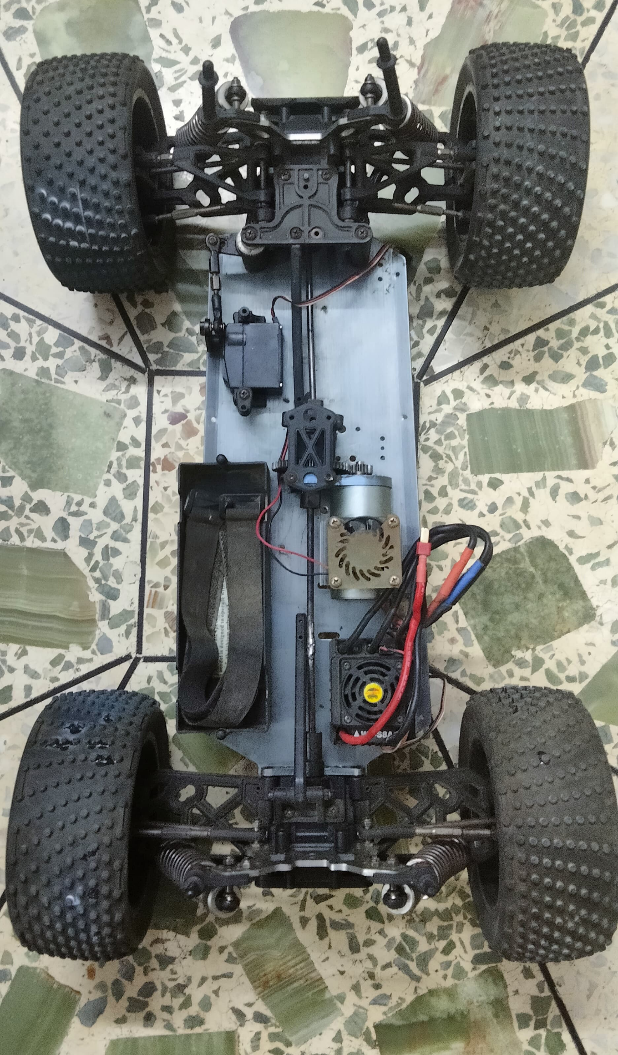
Challenges
Market Efforts: Pitched and Obtained Funding from Wootech
Product not Prototype:
Complexities in term of Product
Non-Linear Acceleration of ATV
Product pitched to clients
5

Slide 6
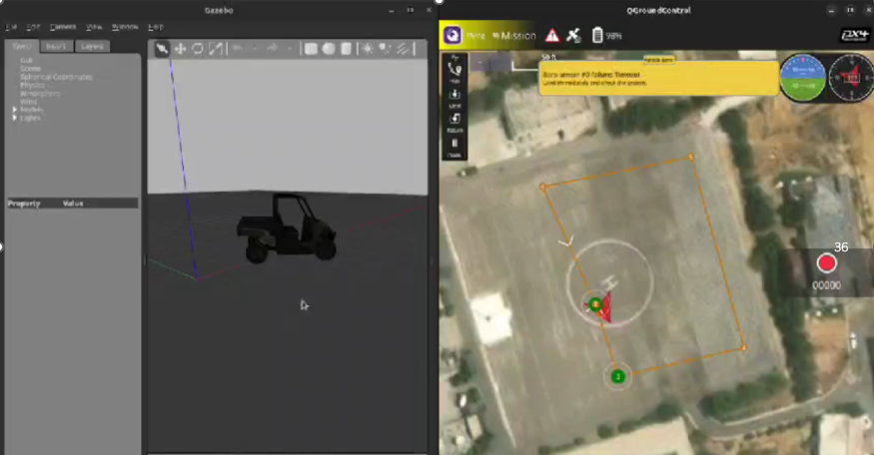
Simulation Aspect 100%
Implemented Gazebo as the Simulation Platform
Successfully integrated PX4 to develop low level control
Successfully integrated ROS2 to develop low level control
Implemented Point to Point Navigation using this
6

Slide 7
Mechanical Aspect 100% Completed
Design of Vehicle Body: CAD (Completed)
Vehicle Dimensions (5x2x2 ft)
Procurement of Material (Completed)
Welding and Testing (Completed)
7

Slide 8
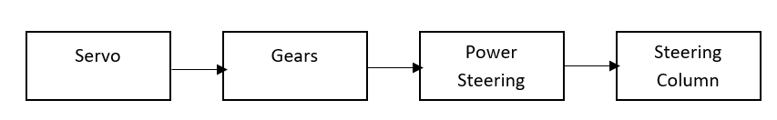
STEERING Control Mechanism
The mechanical Power is transferred from the 180 Kg/s servo through the gears, power steering and finally to the Steering column.
8

Slide 9
System Architecture
GPS /SPEED SENSOR / IMUs
EMBEDED COMPUTER
RUNNIING ROS2
HIGH LEVEL PATH PLANNER
LIDAR
PIXHAWK Low Level Controller
DEPTH CAMERA
INPUT
OUTPUT
CONTROL
MOTORS /
Actuators
PAY LOAD
9

Slide 10
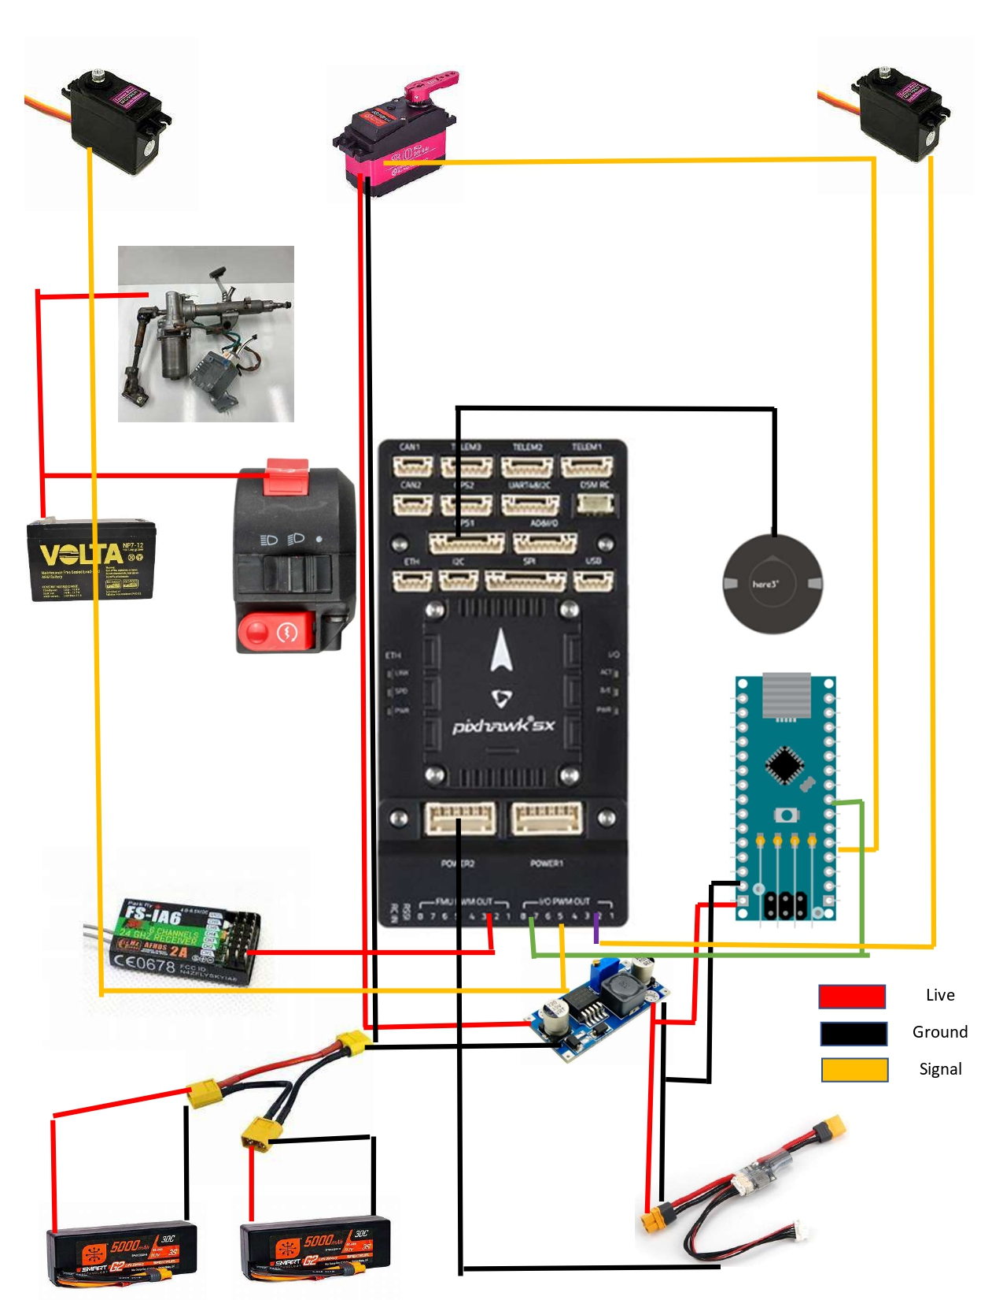
10

Slide 11
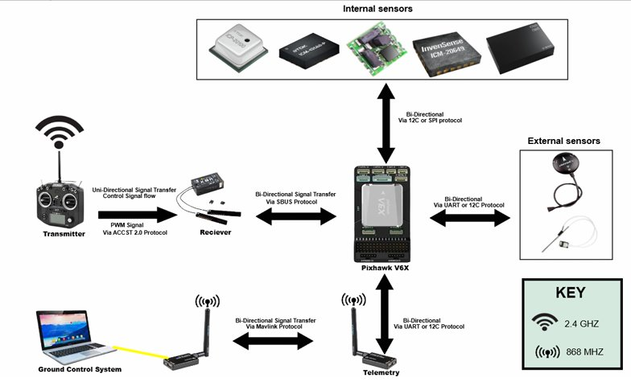
Communication Flow Diagram
11

Slide 12
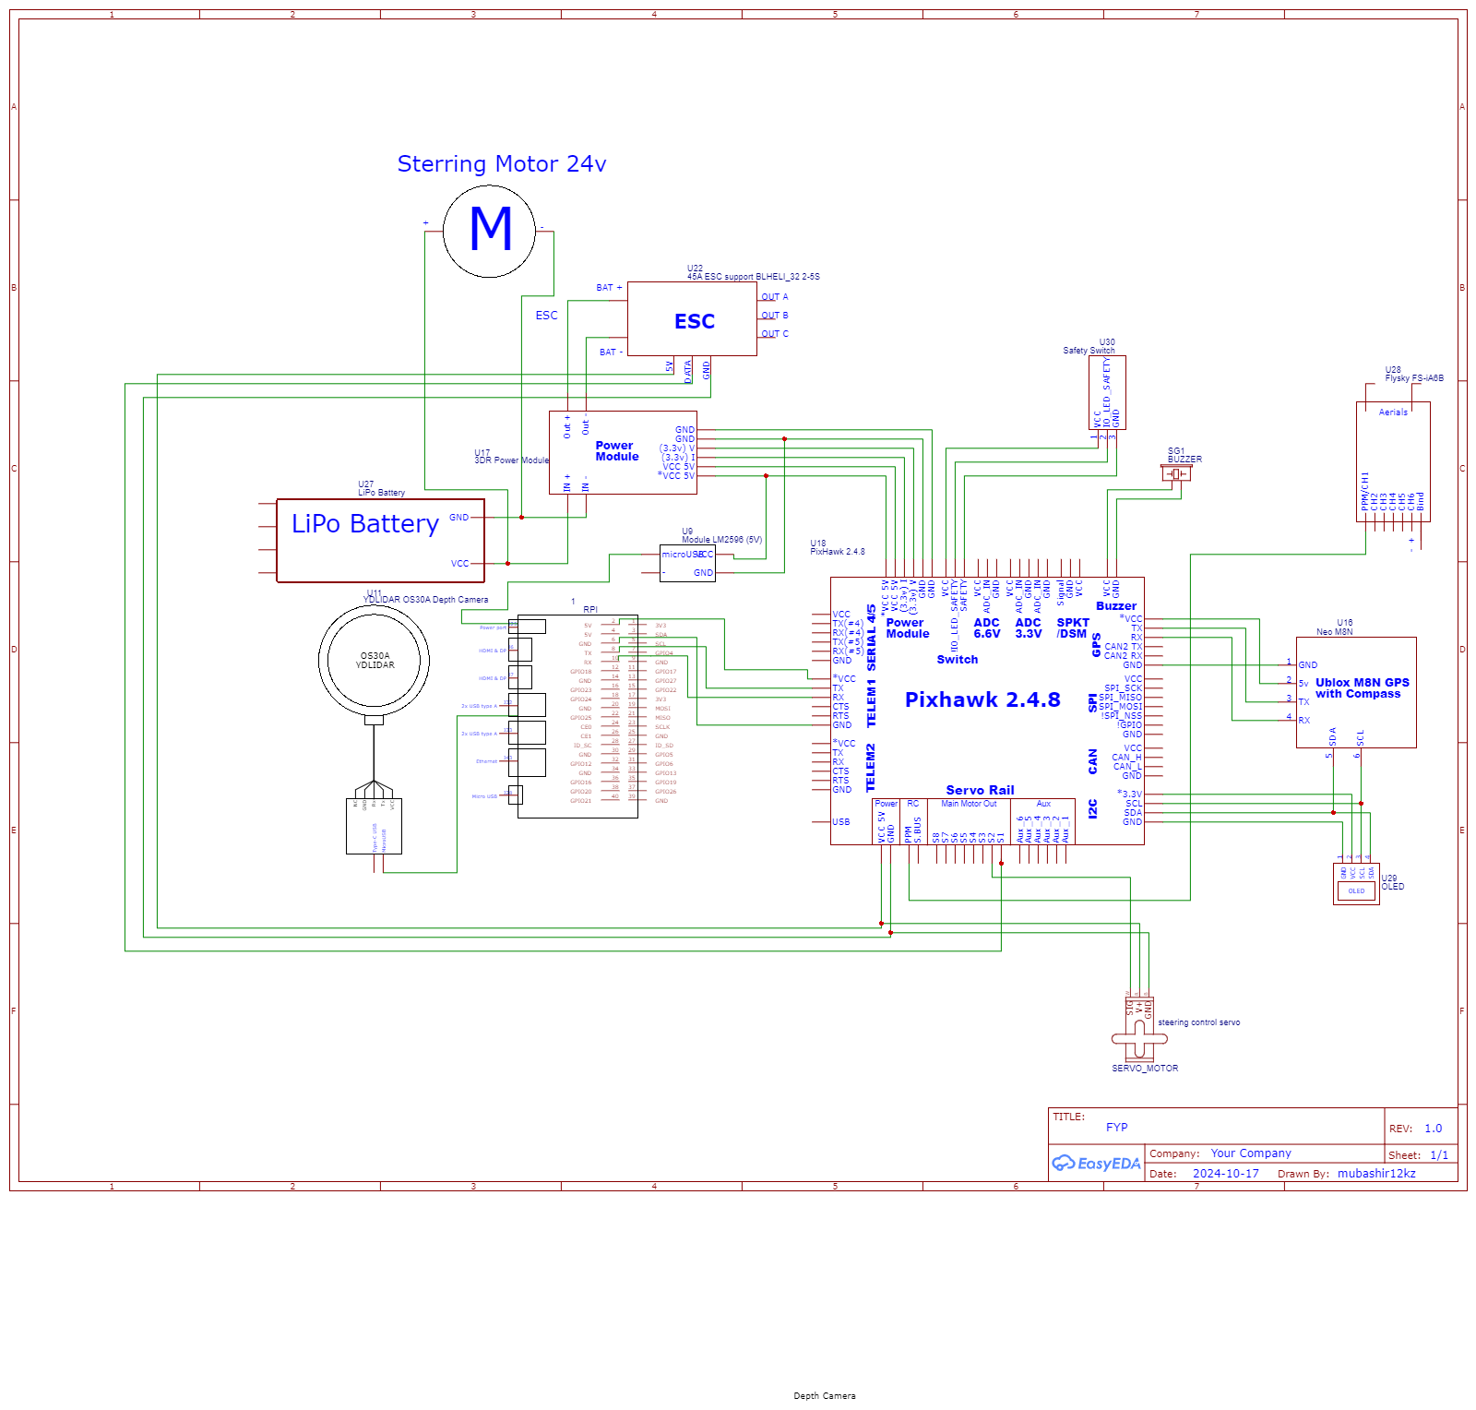
Wiring Diagram
12

Slide 13
Electrical Aspect- 100 %completed
Wiring of the vehicle
Integrated Pixhawk controller with the vehicle
This involves integrating servos to ensure control of brakes and accelerator
Wiring the Power Steering
Integration of servo of steering and PX4
Power division across the vehicle
13

Slide 14
ATV SPECIFICATIONS
Parameter | Specification
Top Speed | 25–30 mph (40–48 km/h)
Fuel Economy | ≈25 mpg (≈10.6 km/L)
Engine Type | Single‑cylinder, 4‑stroke, air‑cooled (≈6.5 hp)
Displacement | 107 cc
Max Torque | 4.55 ft·lb (≈6.2 N·m)
Transmission | Automatic CVT (chain drive)
Starting System | Electric start
Fuel Tank Capacity | 2.4 L
Net Weight | 154 lbs (70 kg)
Max Rider Load | 60 kg (132 lbs)
Ground Clearance | 3 in (≈76 mm)
Tire Size | 4.5 × 7‑6 (F/R), strong all‑terrain tread
Rough‑Terrain Capability | Moderate mud, dirt trails; inclines up to ≈15°
14

Slide 15
Software Development
Implementation of Pure Pursuit Control
Implementation of Corner Cutting Logic
Implementation of Fail Safe
Development of Script to integrate PX4 and Ros2
15

Slide 16
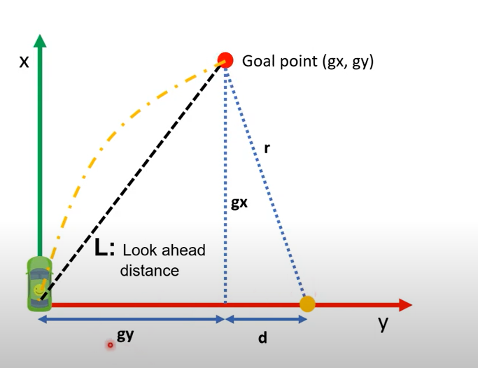
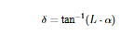
Pure pursuit controller
Work Like how humans drive.
It works like chasing a moving point
Steering angle is calculated
Where
Delta= Steering angle
L= radius to goal point
Alpha= is the curvature
16

Slide 17
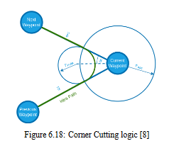
Corner Cutting logic
Ensures Smooth Transition between waypoints
NAV_ACC_Reached
Low Value: Precise check point reached, abrupt or longer transition
Higher Value: Smoother Transition, but may avoid check point by a longer margin
17

Slide 18
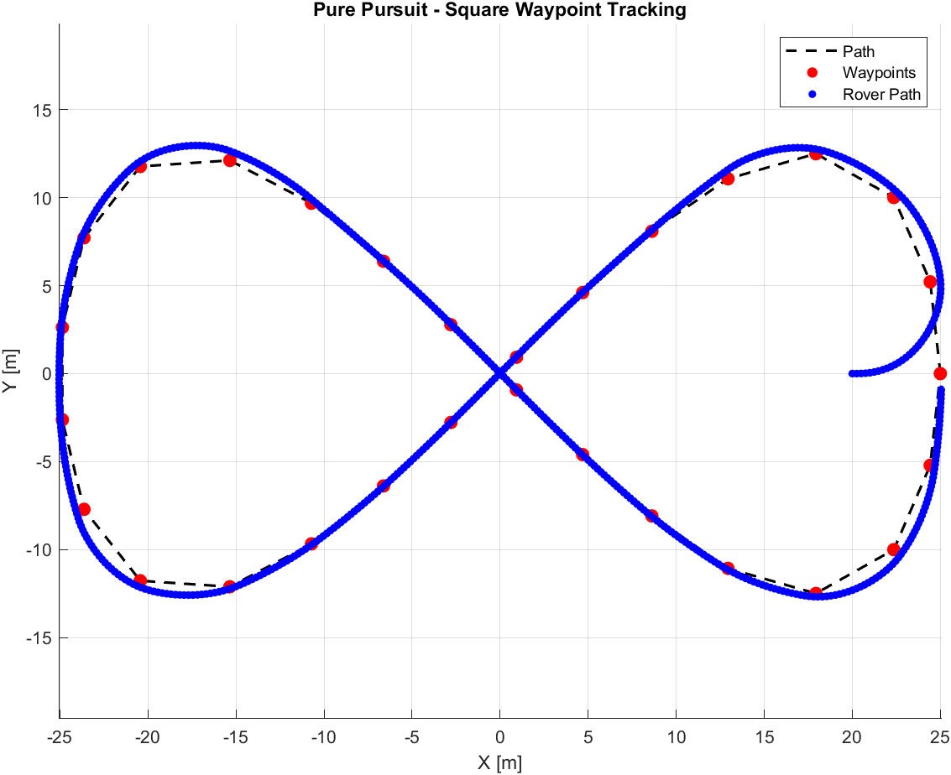
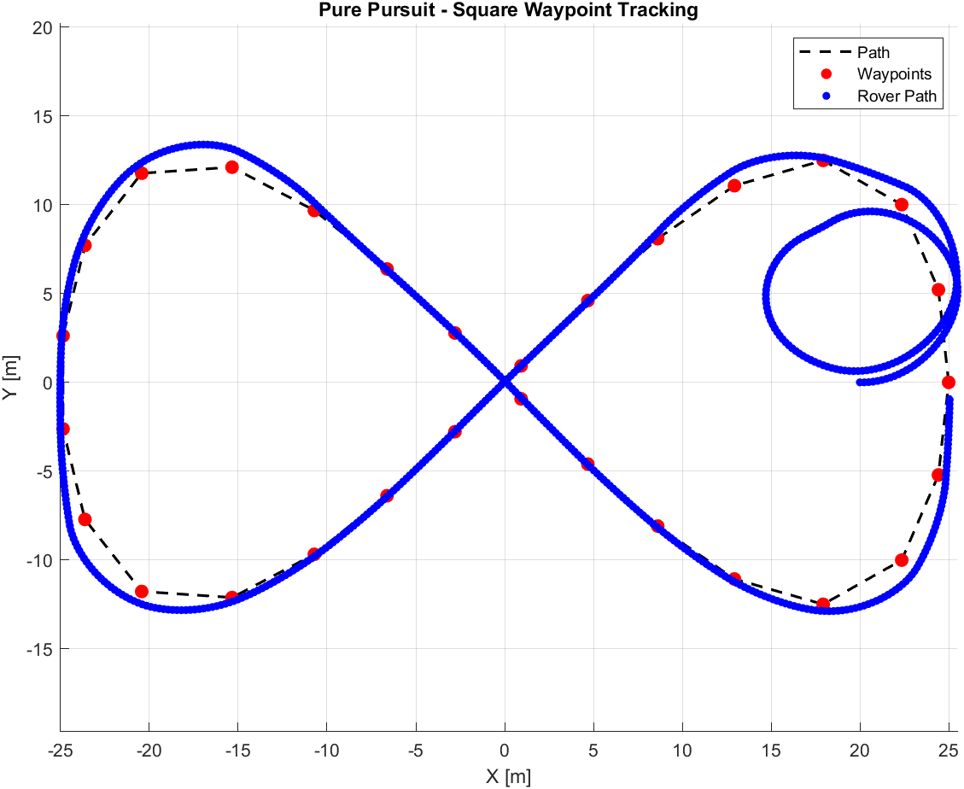
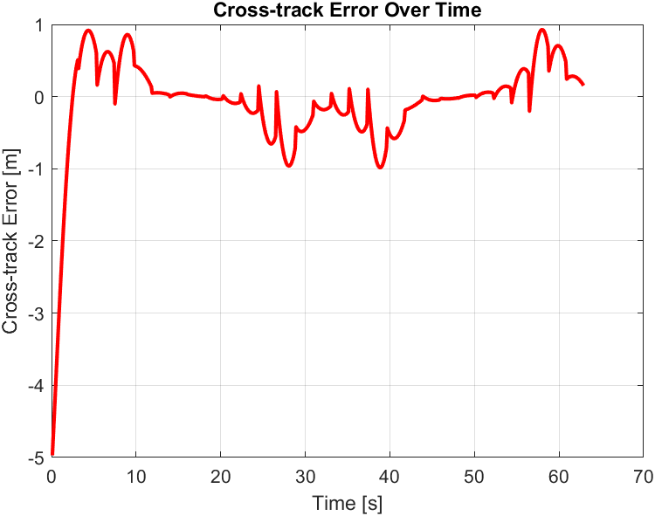
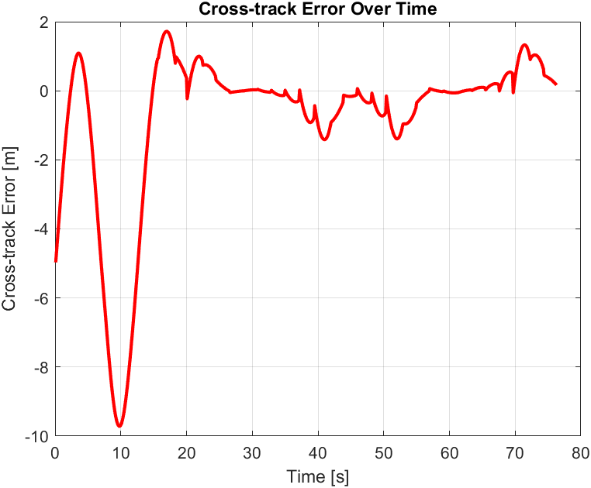
Results- vehicle Simulation In MATLAB
18

Slide 19
Failsafe Implementation
ID | Failure Mode | Effect | Severity | Action
1 | GPS Failure | Vehicle loses navigation control | Major | Activate remote override/manual control
2 | Radio Communication Loss | Loss of remote control | Major | Activate autonomous emergency brake
3 | Acceleration Fault | Uncontrolled speed | Major | Trigger remote kill switch
19

Slide 20
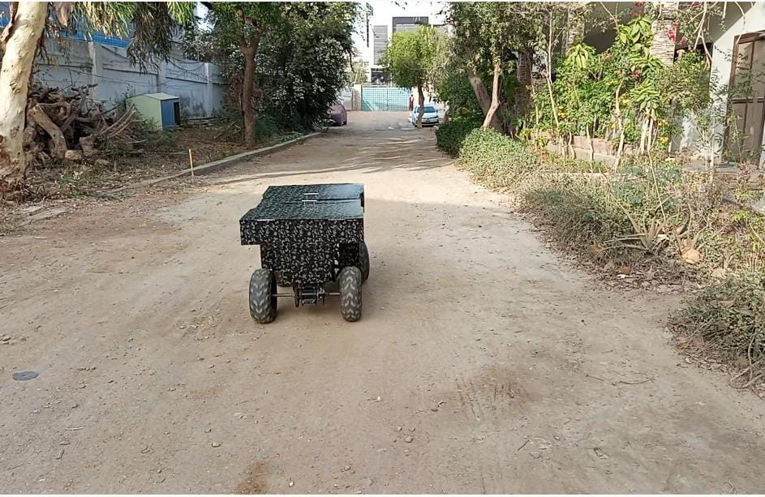
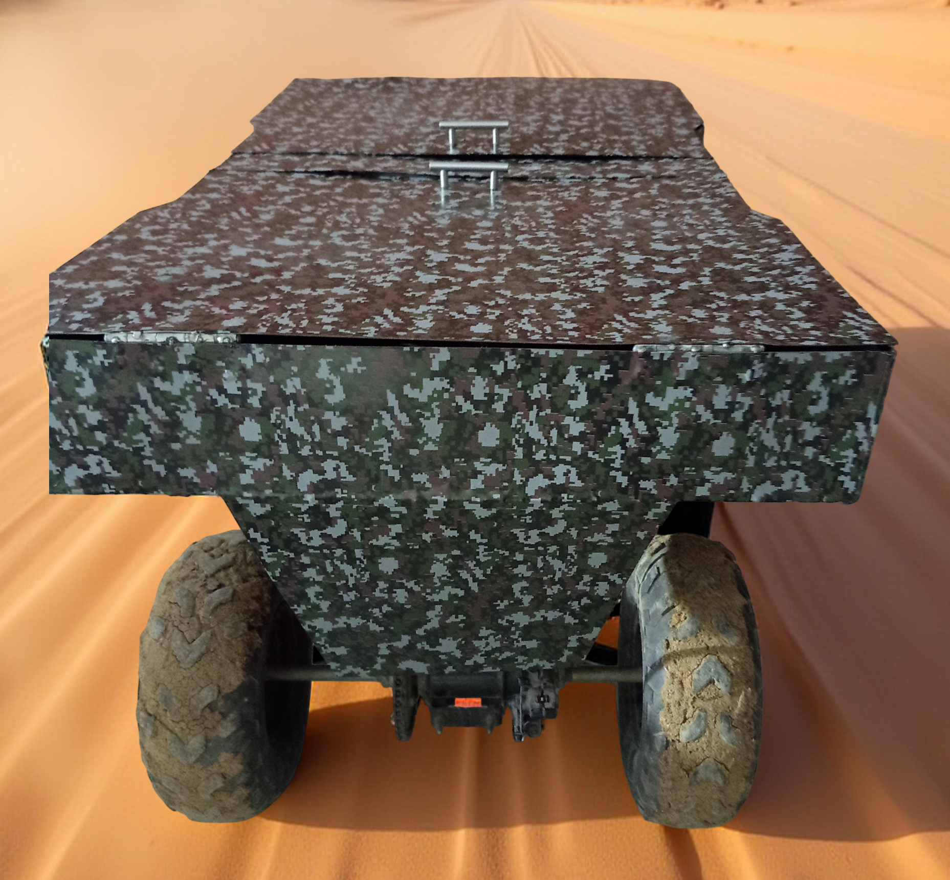
Results
20

Slide 21
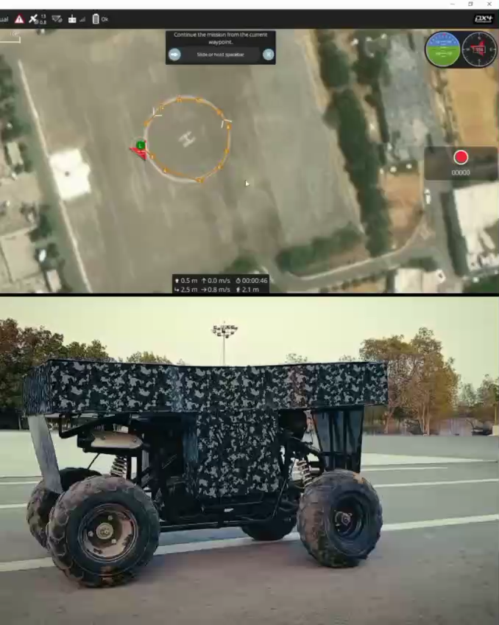
Autonomous Driving in Prade Ground
21

Slide 22
Results obtained so far
Simulation Development
Automation of Vehicle
Acceleration & Brake Control
Self Starting
Steering Control
Mechanical Body Design
CAD, Welding, Wrapping
Software Development for Autonomous Navigation

Slide 23
How is our Project Different?
Industry Funded:
Sponsored by Wootech
Simulation Platform + Open-Source Framework shows generalizability
Tested and Validated on actual ATV
RC and Autonomous Capable ATV
23

Slide 24
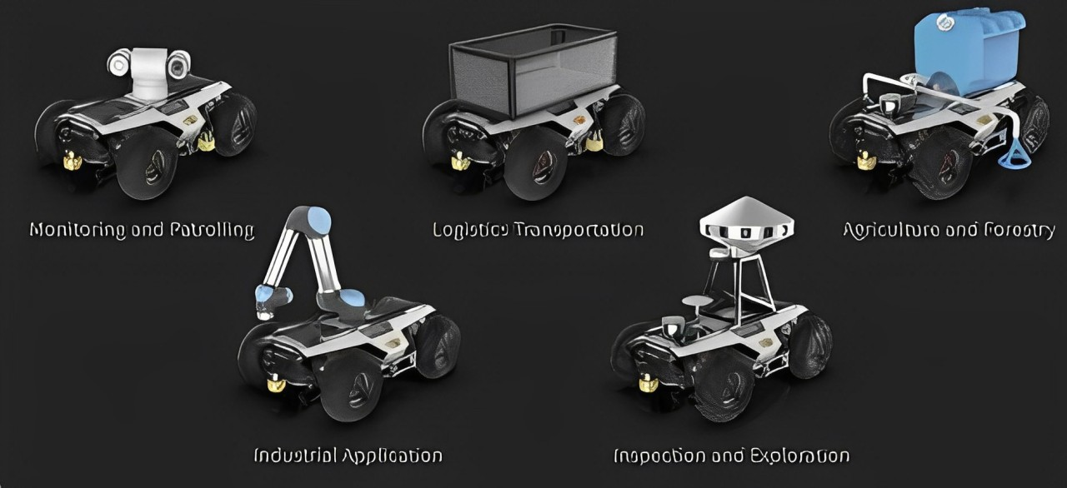
Monitoring and Patrolling
Logistics and Transportation
Agriculture and Forestry
Industrial Application
Inspection and Exploration
24

Slide 25
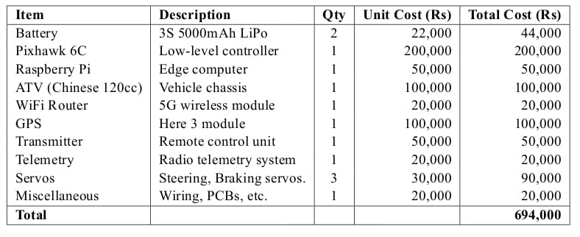
Bill of materials
25

Slide 26
Work Division
Sheharyar Faisal
Group coordinator
Simulation
Software modification
Muhammad Abdullah
Project Coordinator
Hardware and Software Automation
Control
Muhammad Tayyab
Software Coordinator
Rover Navigation
Simulation Model Setup
M. Mubashir Khanzada
Hardware Coordinator
Electrical Integration
Power distribution

Slide 27
References
Kalaria, Dvij et al. “WROOM: An Autonomous Driving Approach for Off-Road Navigation.” ArXiv abs/2404.08855 (2024): n. pag.
Li, Dianzhao & Auerbach, Paul & Okhrin, Ostap. (2024). Towards Autonomous Driving with Small-Scale Cars: A Survey of Recent Development.
A. Cortner, J. M. Conrad and N. A. BouSaba, "Autonomous all-terrain vehicle steering," 2012 Proceedings of IEEE Southeastcon, Orlando, FL, USA, 2012, pp. 1-5, doi: 10.1109/SECon.2012.6196932. keywords: {Microcontrollers;Heating;Steering systems;Pulse width modulation;Vehicles;Navigation},
Levinson, J., Montemerlo, M., & Thrun, S. (2011). Map-based precision vehicle localization in urban environments. Robotics: Science and Systems Conference (RSS).

Slide 28
THANK YOU : )

Slide 29
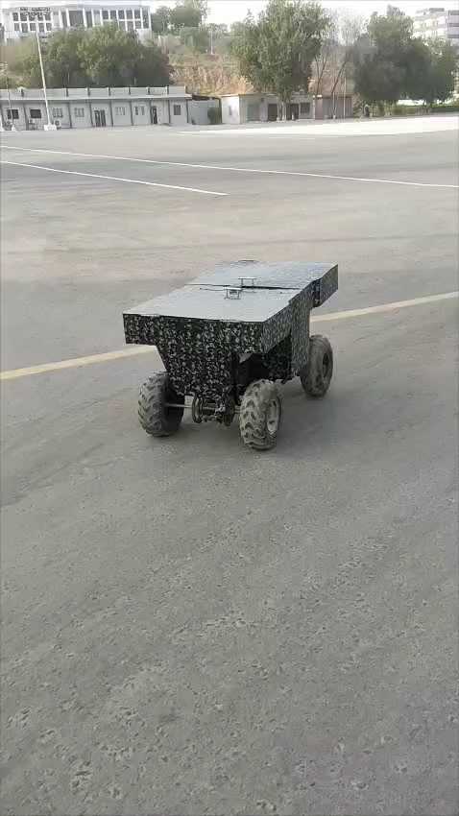
Extreme Testing

